Slide 1

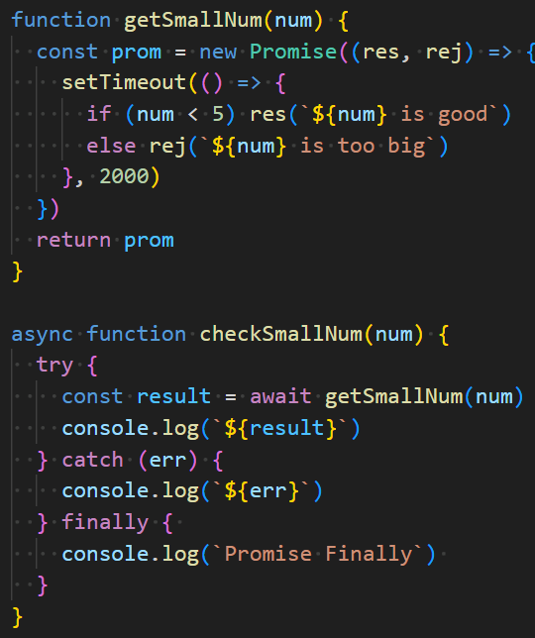
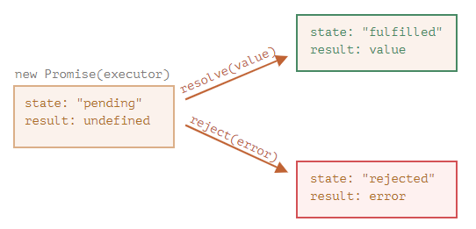
Immediate execution of the callback
Reg timer callback - not executed
Continue with main whilst waiting
When promise resolved, continue with suspended code
Call function returning promise
Needs to be async to use await
Return pending - wait
Pending
Resolved
Rejected
Looking at the same example
Still uses a promise but async await syntax
Do this regardless
demos/async/asyncAwait1b.js

